Slide 1
Application Properties and Logs

Slide 2
What are application properties
Why do we use application properties and its advantages
How to check the application properties
How to check application logs

Slide 3
What Are Application Properties?
Application properties is a file in which we define the configurable application parameters to change an application's behavior.
Where do we set the application properties?
Jenkins

Slide 4
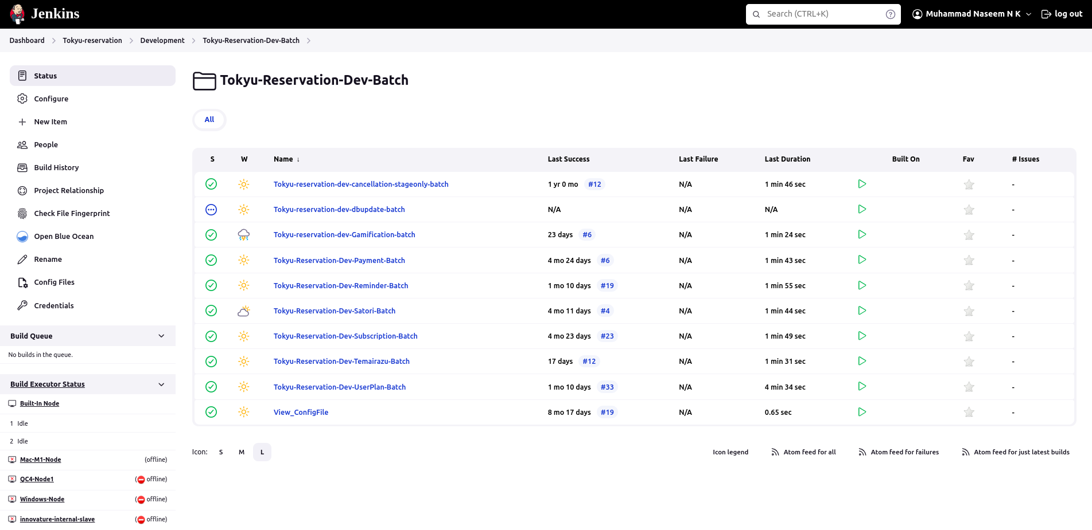

Slide 5
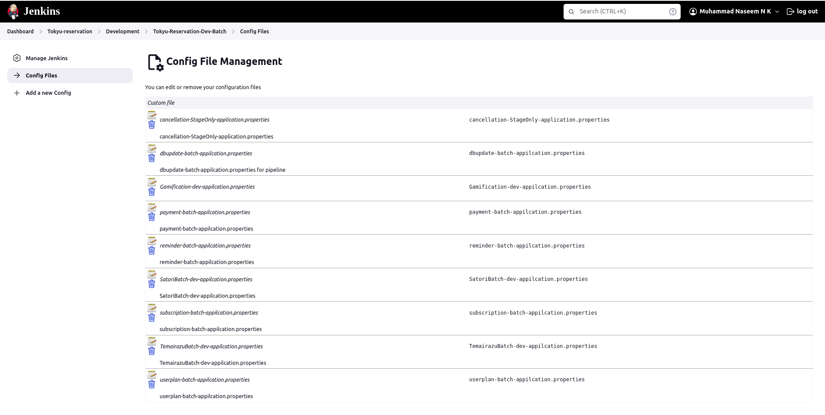

Slide 6
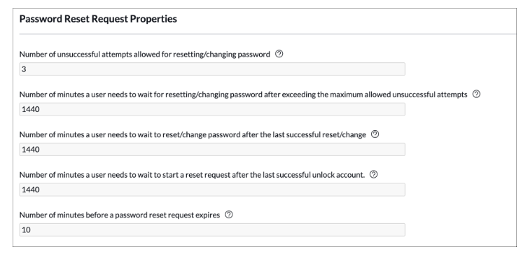
Some examples
reset.password.expiry=3
image.size=10485761
The Number of unsuccessful attempts allowed for resetting/changing password property could easily have been hardcoded into the Password Reset's application's script logic. If business requirements change and the value needs to be 2 attempts instead of 3, an application developer would have to change the code. A new version of the application would have to be tested, published, and installed on all instances running the application. Using an application property instead of hard-coding values allows the application's behavior to change without having to modify code or install new versions.

Slide 7
Advantages
The advantage of using application properties is you can change the value without changing code.
If the same value is used in multiple modules in the system, all we need to do is change the value in the properties file.

Slide 8
Does the application change immediately after the application properties has ben changed?
Build and Deploy
Build means to Compile the project.
The output of the build process will be a .jar file which contains the source code and the application properties file.
Deploy means to Compile the project & Publish the output
Copies the newly generated .jar file and paste it in the server.

Slide 9
What happens if we forgot to add a property in the application properties file?
If the key is missing
CORS ERROR in Api
If the key value is wrong
An additional space in key value can cause feature to stop working

Slide 10
Application Logs
An Application log file is a simple text document that contains all activities of a specific application in a given period of time Basic types of entries
INFO
WARN
ERROR

Slide 11
How to check application log from server
Steps
1.Login to the server and access the location of the log file
cd /data/currentapp/user/logs
2.Locate the log file
3.Run the commands
tail –f filename.log
tail – 500 filename.log
less filename.log
cat filename.log
zless –f filename.log
zcat filename.log

Slide 12
THANK YOU

